Slide 1
MLL phase contrast
Simple forward propagation

Slide 2
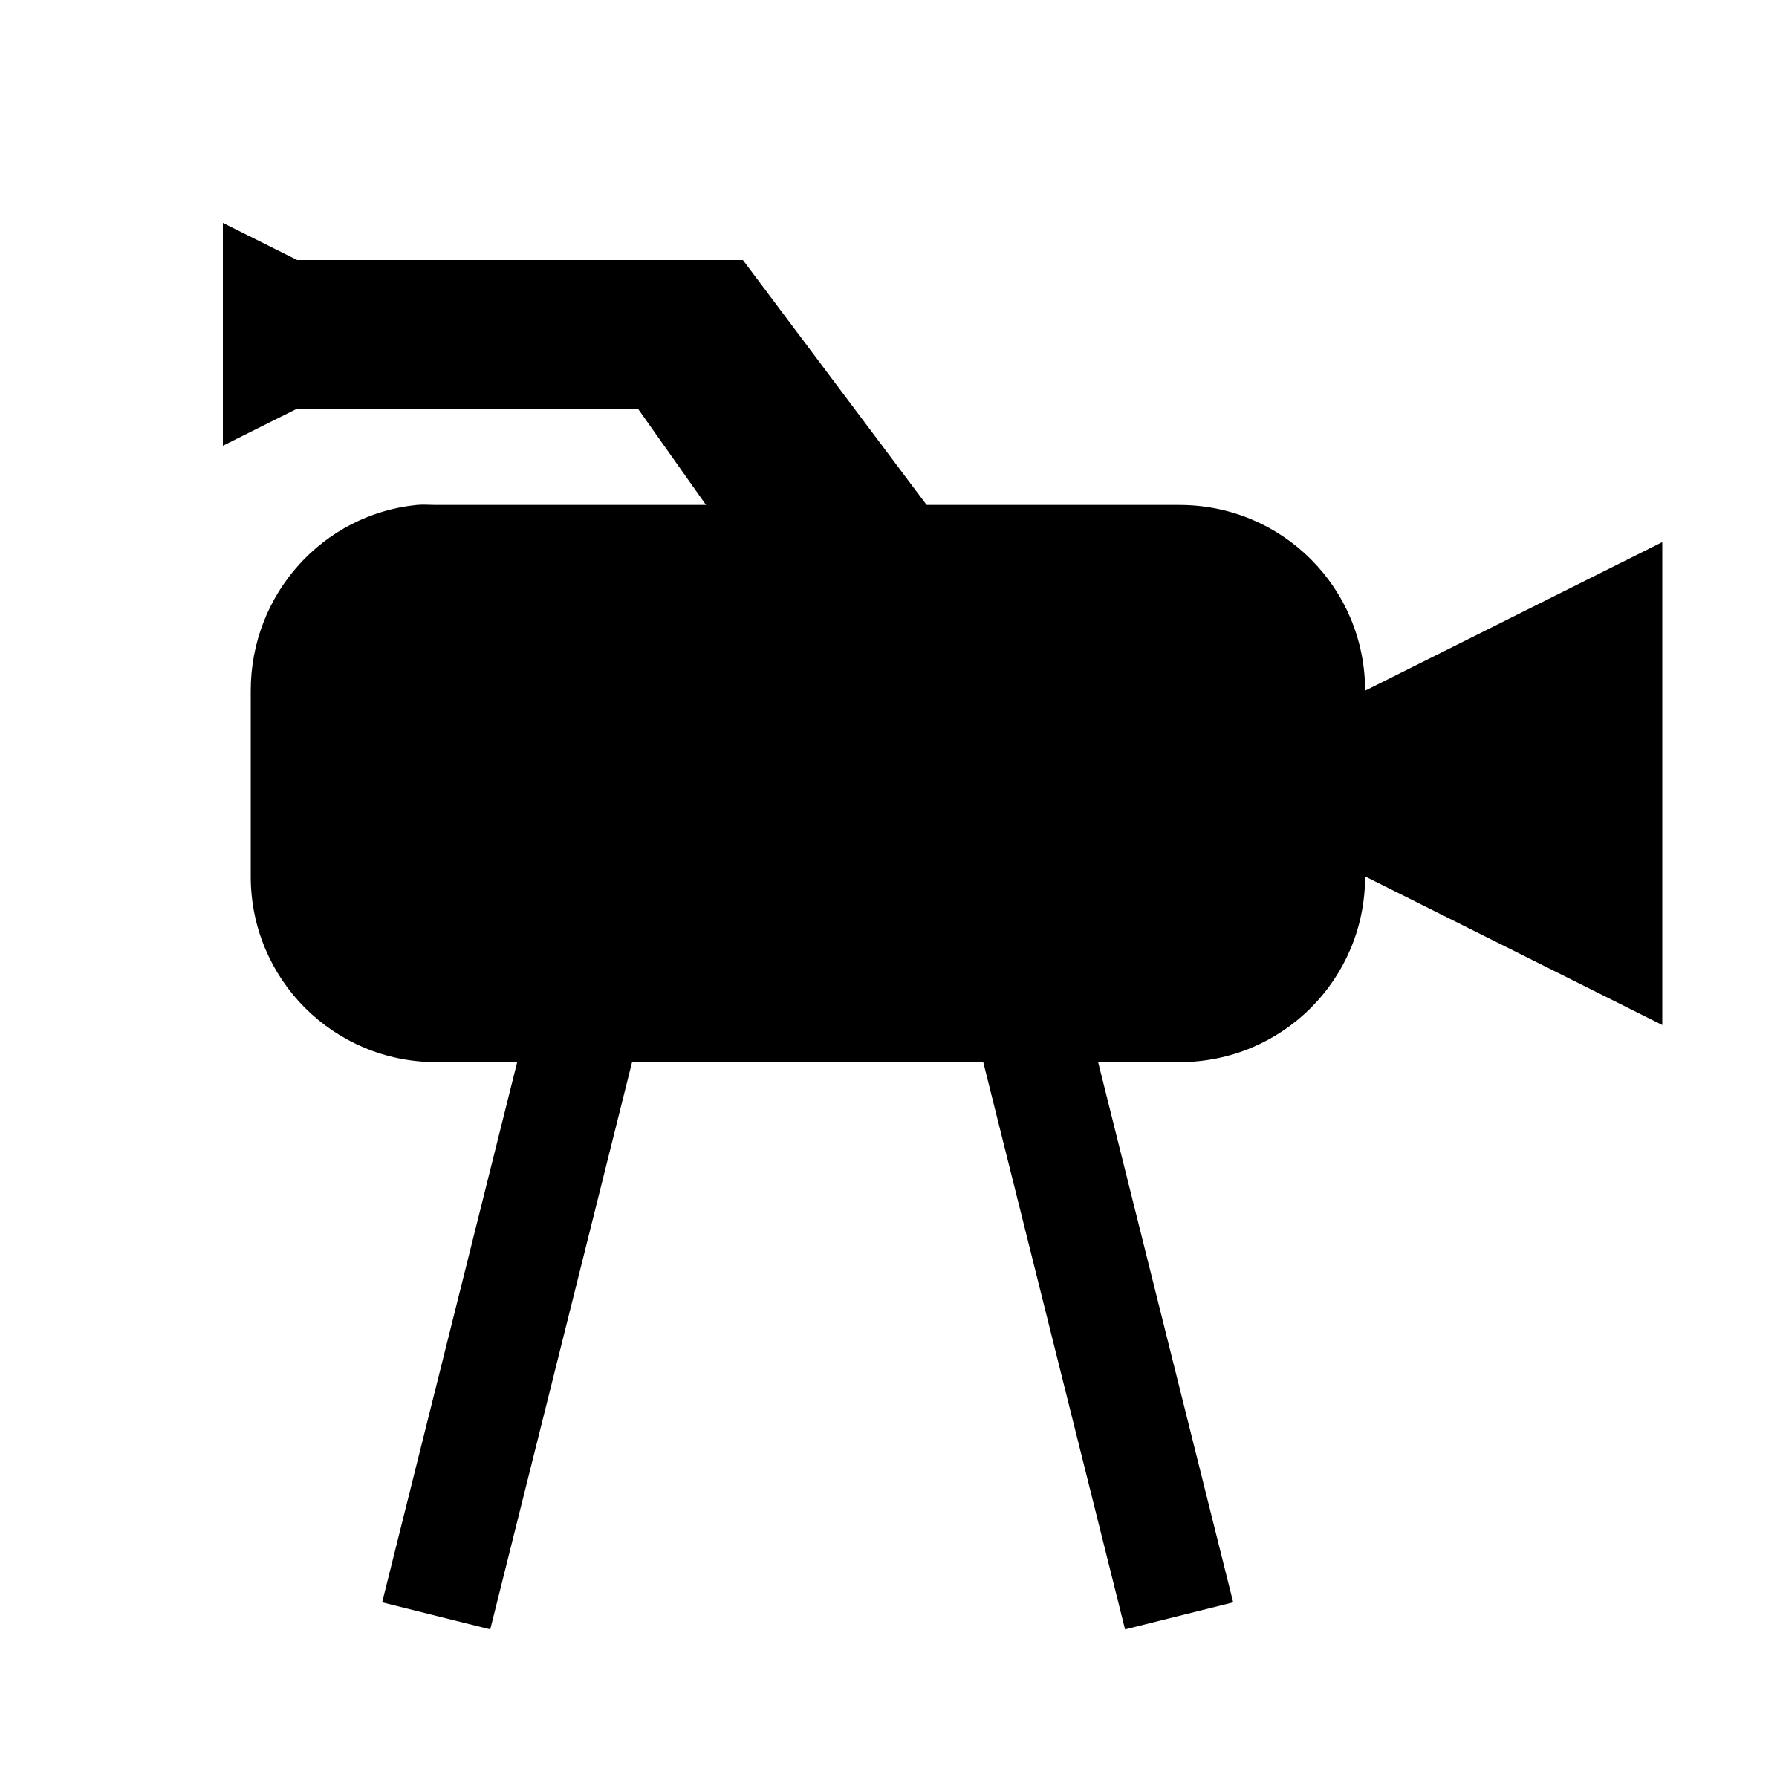
Simulation setup
Horizontal focus, 40 µm aperture
Vertical focus, 46 µm aperture
9.6 mm
4.7 mm
630 mm

Slide 3
Simulation parameters
Assuming perfect focus on the setup in last slide
Focal lengths
H: 9.45 mm
V: 13.98 mm
Magnification
H: 64.6
V: 43.1
Resolution (aperture limited)
H: 17.2 nm
V: 22.3 nm
Pixel size (taking magnification into account)
H: 11.5 nm
V: 17.2 nm

Slide 4
Simulation details
Sampling
Using double field of view (vs detector)
Using half pixel size (vs detector)
In total 8192x8192 pixels
Detector image obtained by binning 2x2 and reducing FOV by x2
MLLs
Assuming simple 1D lenses with perfect phase
Aperture applied
Misc
Perfect coherence assumed

Slide 5

Simulation image
200
400
600
800
1000
1200
1400
1600
1800
2000
500
1000
1500
2000

Slide 6
Data set
Using series Set4_2D_17.3keV
Using scan pco_focus_30s
Bright field, full field images
During this scan the lenses were moved together along the optical axis
Steps of 0.1 mm
41 images

Slide 7
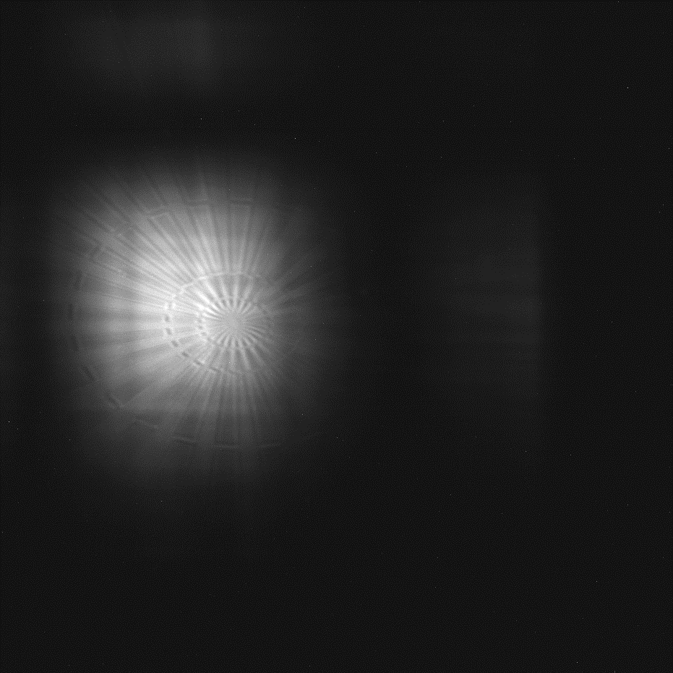
Data “issues”
1200
200
FOV motion during scan
400
1000
600
800
800
1000
600
1200
1400
400
Star motion during scan
1600
200
1800
2000
0
500
1000
1500
2000

Slide 8
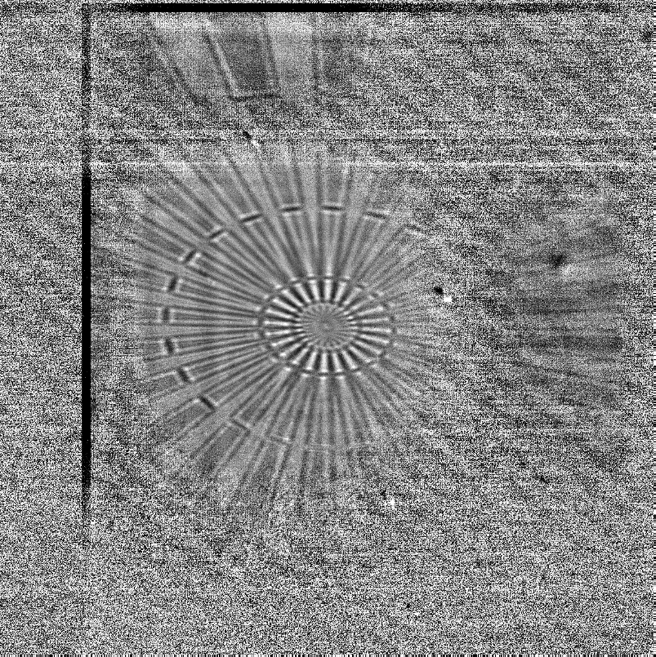
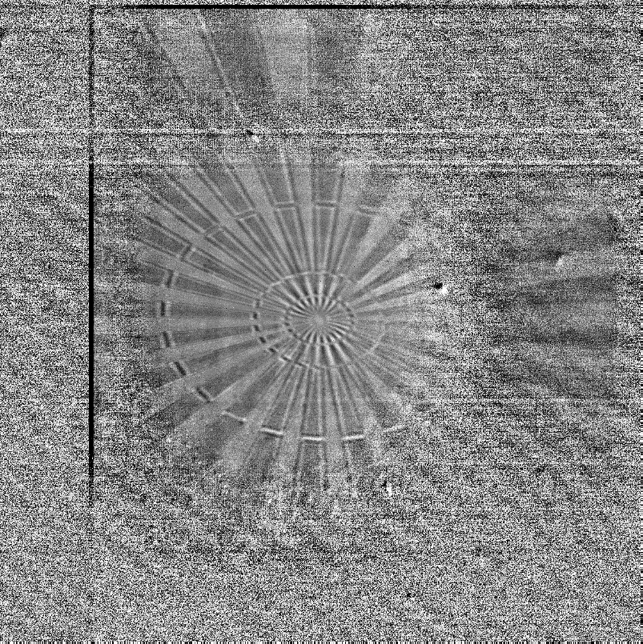
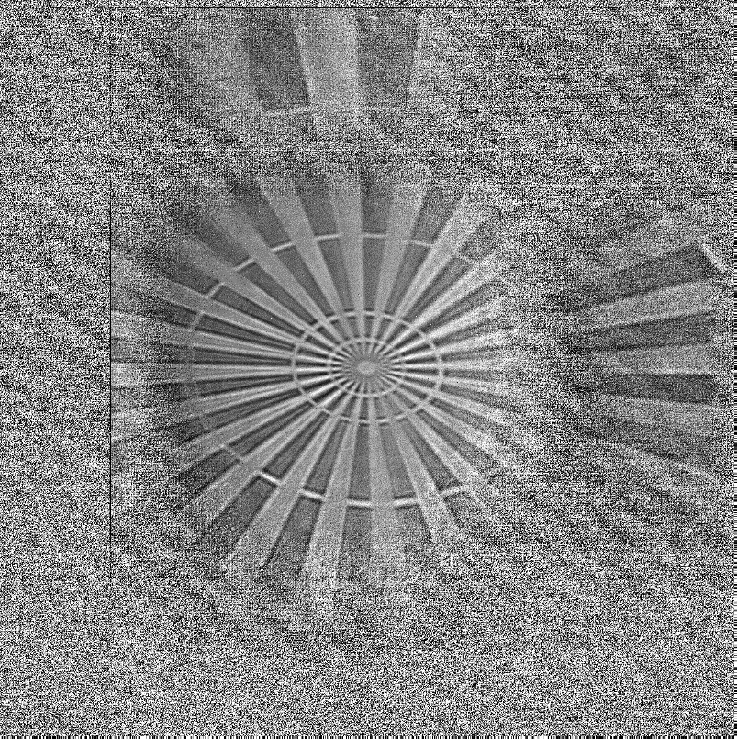
Corrected data
200
200
200
400
400
400
600
600
600
800
800
800
1000
1000
1000
1200
1200
1200
1400
1400
1400
1600
1600
1600
1800
1800
1800
2000
2000
2000
500
1000
1500
2000
500
1000
1500
2000
500
1000
1500
2000

Slide 9
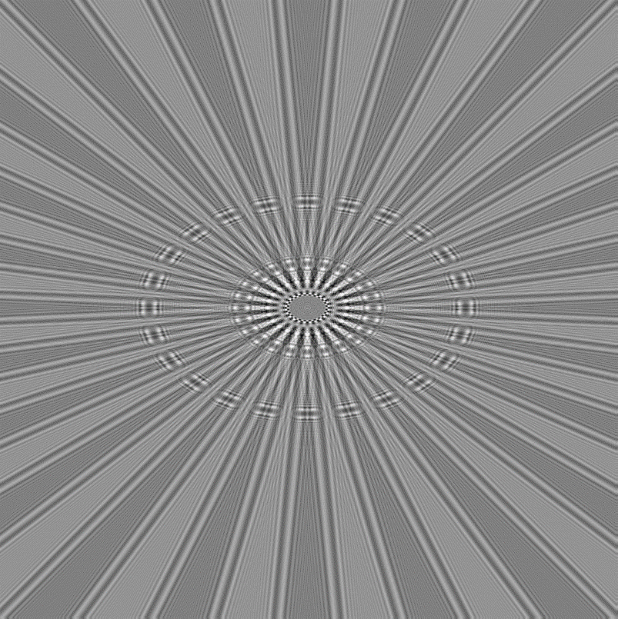

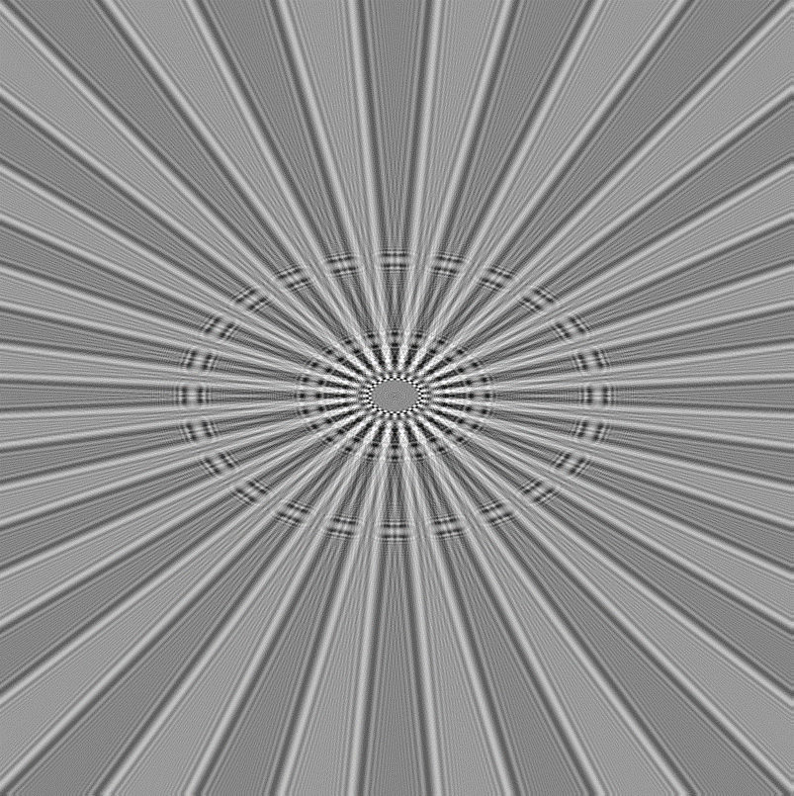
Simulated data
Simulation of a series of images moving both lenses in steps of 0.1 mm along optical axis
200
200
200
400
400
400
600
600
600
800
800
800
1000
1000
1000
1200
1200
1200
1400
1400
1400
1600
1600
1600
1800
1800
1800
2000
2000
2000
500
1000
1500
2000
500
1000
1500
2000
500
1000
1500
2000

Slide 10
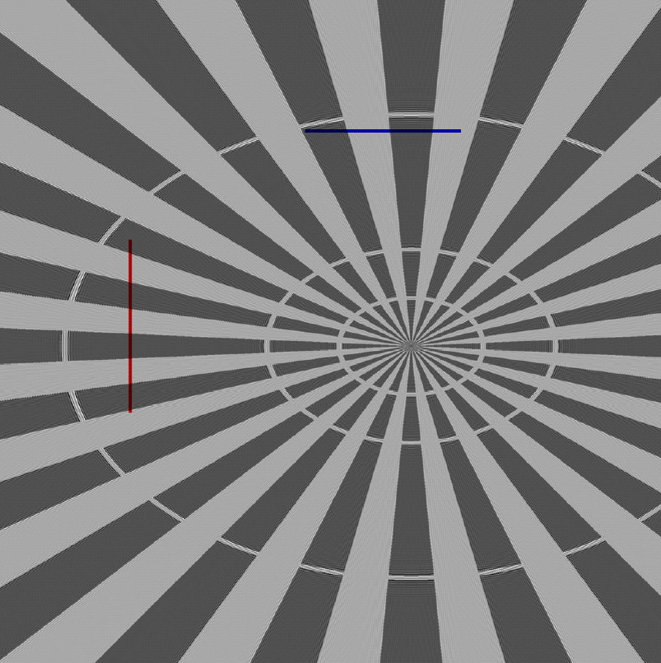

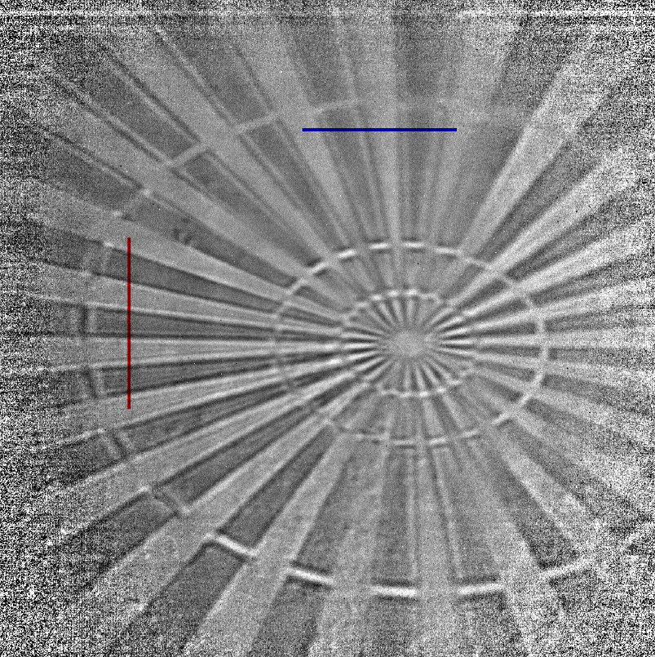

Line profiles
500
500
600
Horizontal line profiles (3 pixel average)
600
700
700
800
800
900
900
1000
Vertical line profiles (3 pixel average)
1000
1100
1100
1200
1200
1300
1300
1400
1400
1500
400
600
800
1000
1200
1400
1500
400
600
800
1000
1200
1400

Slide 11
Line profiles
Interference features in the center of spokes only seen in simulation, could be due to partial coherence in the measurement.
The edge enhancing phase contrast is well reproduced.
Horizontal
Vertical
Astigmatism in data
Data
Simulation
The x- and y-axis have been shifted and scaled to align to the data. The intensities have been scaled using the mean and standard deviation.

Slide 12
Outlook
With this simple simulation the results are quite well reproduced
More detailed model
Include partial coherence
(Include astigmatism and correct magnification factors by tuning focal lengths)
Include phase distortions of lenses

